Slide 1
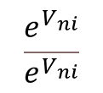
Derivation of the Binary Logit Model
Note: n denotes individual and i and j are alternatives (i.e., two choices)
Using Property 5
Recall Property 5: The difference of two independent Gumbel RVs with the same scale (and variance) follows a logistic distribution.
Multiple
Binary Logit Model
1

Slide 2
Derivation of the Multinomial Logit Model
Recall the setup of the multinomial logit model
P_{n} (k/A_{n}) = probability that an individual ‘n’ will choose alternative ‘k’ from the choice set A_{n} = {1, 2, ... , k, ... M}
Self-practice problem: Derive the multinomial logit model as follows:
2

Slide 3

Method 1: Derivation of the Multinomial Logit Model
Using Property 6
Using Property 5
Multiple
Binary Logit Model
3

Slide 4
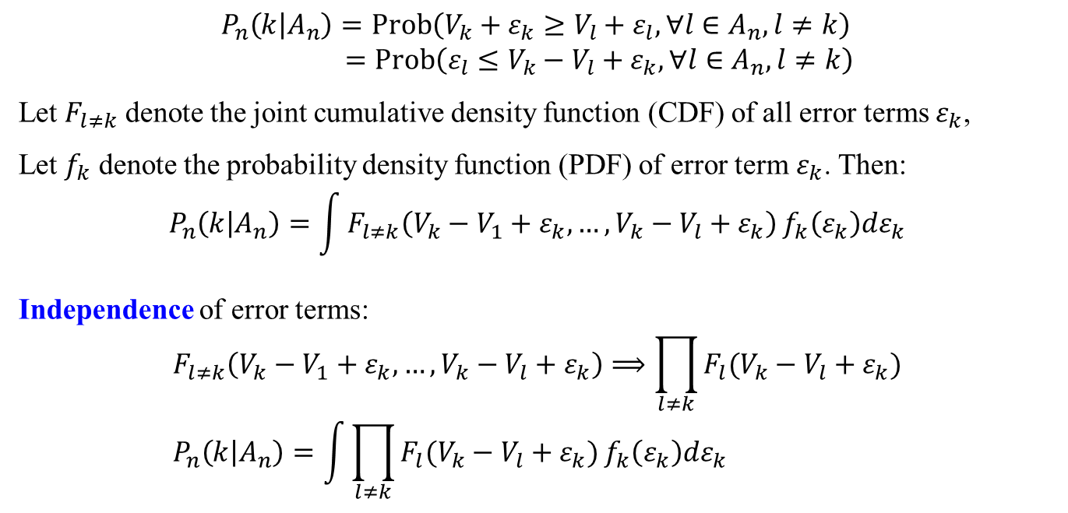
Method 2: Derivation of the Multinomial Logit Model
P_{n} (k/A_{n}) = probability that an individual ‘n’ will choose alternative ‘k’ from the choice set A_{n} = {1, 2, ... , k, ... M}
$$P_{n}\left(k | A_{n}\right)=Prob\left(V_{k}+ε_{k}≥V_{l}+ε_{l},∀l∈A_{n},l≠k\right) \\ =Prob\left(ε_{l}≤V_{k}−V_{l}+ε_{k},∀l∈A_{n},l≠k\right)$$
Let $F_{l≠k}$ denote the joint cumulative density function (CDF) of all error terms $ε_{k}$,
Let $f_{k}$ denote the probability density function (PDF) of error term $ε_{k}$. Then: $$P_{n}\left(k | A_{n}\right)=\int{F_{l≠k}\left(V_{k}−V_{1}+ε_{k},…,V_{k}−V_{l}+ε_{k}\right)}f_{k}\left(ε_{k}\right)dε_{k}$$
Independence of error terms:
$$F_{l≠k}\left(V_{k}−V_{1}+ε_{k},…,V_{k}−V_{l}+ε_{k}\right)⟹\prod_{l≠k}{F_{l}(V_{k}−V_{l}+ε_{k})} \\ P_{n}\left(k | A_{n}\right)=\int{\prod_{l≠k}{F_{l}(V_{k}−V_{l}+ε_{k})}}f_{k}\left(ε_{k}\right)dε_{k}$$
4

Slide 5
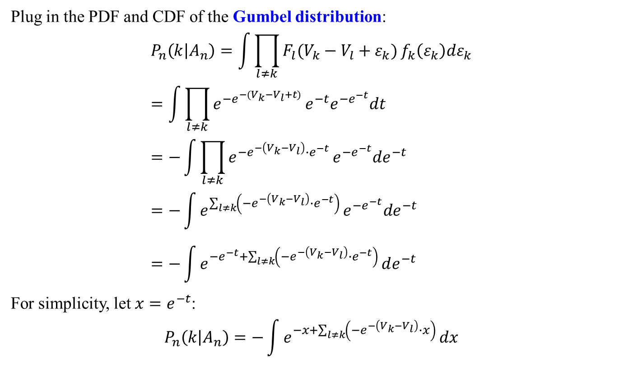
Method 2: Derivation of the Multinomial Logit Model
Plug in the PDF and CDF of the Gumbel distribution: $$P_{n}\left(k | A_{n}\right)=\int{\prod_{l≠k}{F_{l}(V_{k}−V_{l}+ε_{k})}}f_{k}\left(ε_{k}\right)dε_{k} \\ =\int{\prod_{l≠k}{e^{−e^{−(V_{k}−V_{l}+t)}}}}e^{−t}e^{−e^{−t}}dt \\ =−\int{\prod_{l≠k}{e^{−e^{−\left(V_{k}−V_{l}\right)}∙e^{−t}}}}e^{−e^{−t}}de^{−t} \\ =−\int{e^{\sum_{l≠k}{\left(−e^{−\left(V_{k}−V_{l}\right)}∙e^{−t}\right)}}}e^{−e^{−t}}de^{−t} \\ =−\int{e^{−e^{−t}+\sum_{l≠k}{\left(−e^{−\left(V_{k}−V_{l}\right)}∙e^{−t}\right)}}}de^{−t}$$ For simplicity, let $x=e^{−t}$:
$$P_{n}\left(k | A_{n}\right)=−\int{e^{−x+\sum_{l≠k}{\left(−e^{−\left(V_{k}−V_{l}\right)}∙x\right)}}}dx$$
5

Slide 6
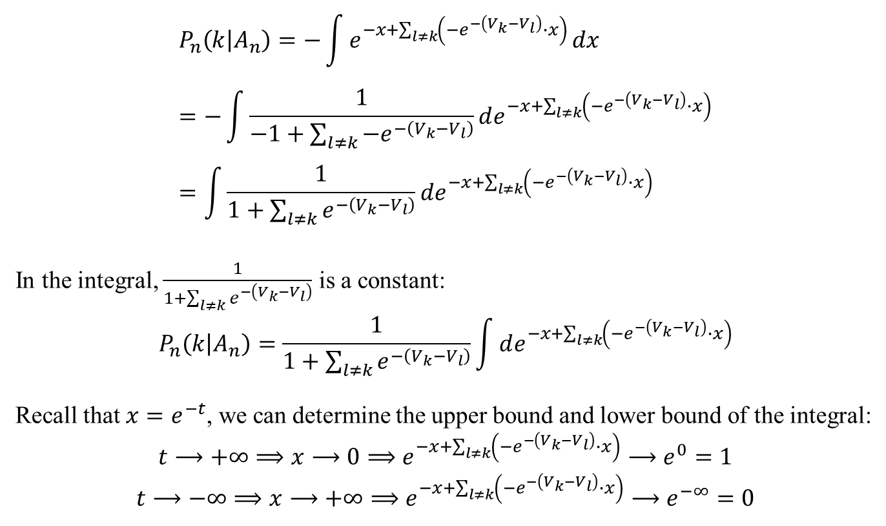
Method 2: Derivation of the Multinomial Logit Model
$$P_{n}\left(k | A_{n}\right)=−\int{e^{−x+\sum_{l≠k}{\left(−e^{−\left(V_{k}−V_{l}\right)}∙x\right)}}}dx \\ =−\int{\frac{1}{−1+\sum_{l≠k}{−e^{−\left(V_{k}−V_{l}\right)}}}}de^{−x+\sum_{l≠k}{\left(−e^{−\left(V_{k}−V_{l}\right)}∙x\right)}} \\ =\int{\frac{1}{1+\sum_{l≠k}{e^{−\left(V_{k}−V_{l}\right)}}}}de^{−x+\sum_{l≠k}{\left(−e^{−\left(V_{k}−V_{l}\right)}∙x\right)}}$$
In the integral, $\frac{1}{1+\sum_{l≠k}{e^{−\left(V_{k}−V_{l}\right)}}}$ is a constant:
$$P_{n}\left(k | A_{n}\right)=\frac{1}{1+\sum_{l≠k}{e^{−\left(V_{k}−V_{l}\right)}}}\int{de^{−x+\sum_{l≠k}{\left(−e^{−\left(V_{k}−V_{l}\right)}∙x\right)}}}$$
Recall that $x=e^{−t}$, we can determine the upper bound and lower bound of the integral:
$$t⟶+∞⟹x⟶0⟹e^{−x+\sum_{l≠k}{\left(−e^{−\left(V_{k}−V_{l}\right)}∙x\right)}}⟶e^{0}=1$$
$$t⟶−∞⟹x⟶+∞⟹e^{−x+\sum_{l≠k}{\left(−e^{−\left(V_{k}−V_{l}\right)}∙x\right)}}⟶e^{−∞}=0$$
6

Slide 7
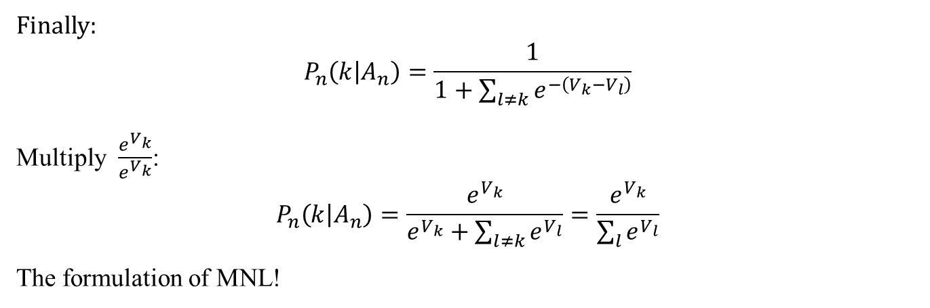
Method 2: Derivation of the Multinomial Logit Model
Finally:
$$P_{n}\left(k | A_{n}\right)=\frac{1}{1+\sum_{l≠k}{e^{−\left(V_{k}−V_{l}\right)}}}$$
Multiply $\frac{e^{V_{k}}}{e^{V_{k}}}$:
$$P_{n}\left(k | A_{n}\right)=\frac{e^{V_{k}}}{e^{V_{k}}+\sum_{l≠k}{e^{V_{l}}}}=\frac{e^{V_{k}}}{\sum_{l}{e^{V_{l}}}}$$
The formulation of MNL!
7

Slide 8
Derivation of the Multinomial Logit Model
n = individual; i = alternative
8

Slide 9
Derivation of the Multinomial Logit Model (1)
Using the independent assumption
Assume Gumbel distribution
9
Note: See Appendix 2.1 in Garrow, L.A. (1985) Discrete Choice Modelling and Air Travel Demand: Theory and Applications, Ashgate Publishing Limited.

Slide 10
Derivation of the Multinomial Logit Model (2)
Assume Gumbel distribution
ε_{i} ~ Gumbel(0,1)
Define a new variable w_{i} and S
Substitute the above into the probability equation:
10

Slide 11
Derivation of the Multinomial Logit Model: Moment Generating Function
Moment generating function for ε
11

Slide 12
Derivation of the Multinomial Logit Model: Moment Generating Function
Moment generating function for ε
12

Slide 13
Gumbel Distribution
PDF
Gumbel
Perceived travel cost
Location parameter
Euler constant
Scale parameter
Variance is a function of scale parameter only!!!

Slide 14
Multinomial Logit (MNL) Model and Closed-form Probability Expression
Under the independently distributed assumption, we have the joint survival function:
Then, the choice probability can be determined by
Identically distributed
assumption
To obtain a closed-form, θ is fixed for all routes
Finally, we have
Independently and Identically distributed (IID) assumption

Slide 15

Weibull Distribution
PDF
Alternative
Weibull
Perceived travel cost
Gamma function
Variance is a function of route cost!!!

Slide 16
Multinomial Weibit (MNW) Model and Closed-form Probability Expression
Under the independently distributed assumption, we have the joint survival function:
Then, the choice probability can be determined by
To obtain a closed-form, β and ζ are fixed for all routes
Since the Weibull variance is a function of route cost, the identically distributed assumption does NOT apply
Finally, we have
Castillo et al. (2008) Closed form expressions for choice probabilities in the Weibull case. Transportation Research Part B 42(4), 373-380.

Slide 17
Weibull Distribution
PDF
Alternative
Weibull
Perceived travel cost
Gamma function
Variance is a function of route cost!!!

Slide 18
Multinomial Weibit (MNW) Model and Closed-form Probability Expression
Under the independently distributed assumption, we have the joint survival function:
Then, the choice probability can be determined by
To obtain a closed-form, β and ζ are fixed for all routes
Since the Weibull variance is a function of route cost, the identically distributed assumption does NOT apply
Finally, we have
Castillo et al. (2008) Closed form expressions for choice probabilities in the Weibull case. Transportation Research Part B 42(4), 373-380.

Slide 19
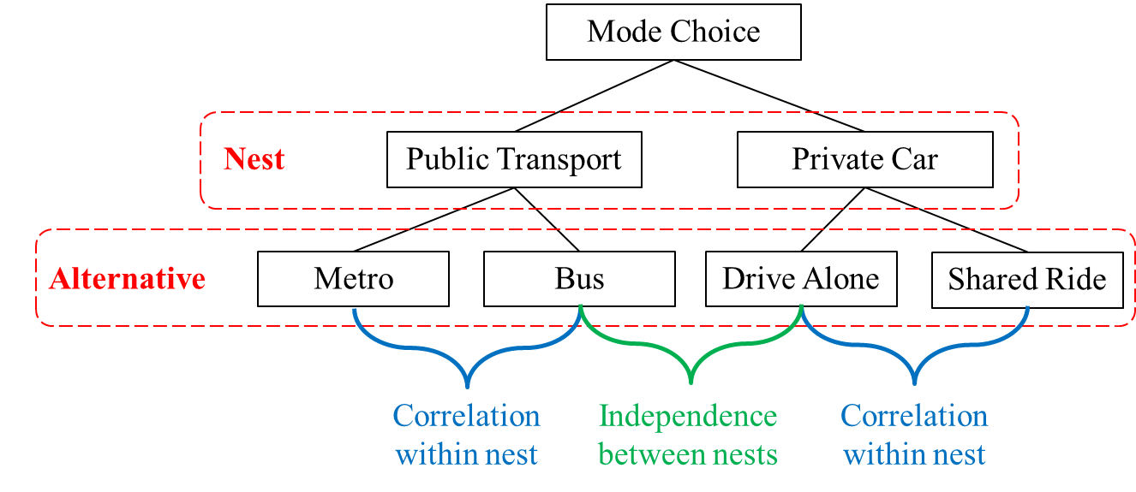
Discrete Choice Model with Nesting Structure
Allow partial relaxation of IIA property of MNL
Useful when some alternatives are not unique (i.e., similar to other alternatives)
Marginal probability (P_{m})
Conditional probability (P_{i|m})
Choice probability (P_{i}= P_{i|m}x P_{m} )

Slide 20
Derivation of the Nested Logit Model (1)
Conditional Probability
Similar to MNL probability (given nest m is chosen)
20
Note: See Appendix 3.1 in Garrow, L.A. (1985) Discrete Choice Modelling and Air Travel Demand: Theory and Applications, Ashgate Publishing Limited.

Slide 21
Derivation of the Nested Logit Model (2)
Marginal Probability of selecting nest m
Make use of Property 6
Probability of selecting alternative i
21

Slide 22
Generalized Nested Logit Model
Remark: Number of nests is given by
N!/{(N-1)! x 2!}
4!/{3! X 2!} = 6
Choice Probability: Conditional Probability x Marginal Probability
22

Slide 23
Generalized Nested Logit Model
Variance-Covariance Matrix
Direct and Cross Elasticity
23

Slide 24
Example 5: C-Logit SUE Formulation
Consider the following loop-hole network
t₁=5, t₂=2, t₃=2+v₃, t₄=1+2v₄, q₁₃=1.
The lengths of links 2, 3, and 4 are equal.
Assume that route choice is governed by a C-logit model with parameters θ=1, β₀=1, and γ=1.
Formulate the C-logit SUE problem.

Slide 25
Example 5: C-Logit SUE Formulation
subject to
Answer:

Slide 26
Example 6: General SUE Unconstrained Formulation
The link numbers and link costs are shown on the respective links. The O-D trip rates are 4 units between nodes 1 and 4, and 2 units between nodes 2 and 4, respectively. Formulate the general SUE unconstrained mathematical program using the logit model as the satisfaction function.
3
origin
3
origin
1
1
1
1
3
3
4
4
destination
destination
2
origin
2
origin
2
2
4
4
Set the dispersion parameter to 1, the answer is:

Slide 27
CNL SUE Unconstrained Programming Formulation
Recall Sheffi’s formulation
For the logit model, the satisfaction function is
For the CNL model, the satisfaction function is
Bekhor, S., Prashker, J.N., 1999. Formulations of extended logit stochastic user equilibrium assignments. In Proceedings of the 14th International Symposium on Transportation and Traffic Theory, Jerusalem, Israel, 351-372.

Slide 28
Check Property of Satisfaction Function
CNL Probability
Bekhor, S., Prashker, J.N., 1999. Formulations of extended logit stochastic user equilibrium assignments. In Proceedings of the 14th International Symposium on Transportation and Traffic Theory, Jerusalem, Israel, 351-372

Slide 29
PCL SUE Unconstrained Programming Formulation
For the PCL model, the satisfaction function is
Bekhor, S., Prashker, J.N., 1999. Formulations of extended logit stochastic user equilibrium assignments. In Proceedings of the 14th International Symposium on Transportation and Traffic Theory, Jerusalem, Israel, 351-372.

